Slide 1

Customer Analytics on Sales
From Exploratory Analysis to Strategies
University of Southern California
Hongfa Huang 3421956392

Slide 2
Contents
Exploratory Analysis
Customer
Segmentation
Customer Life-Time Value
Next Purchase Prediction
Strategies

Slide 3
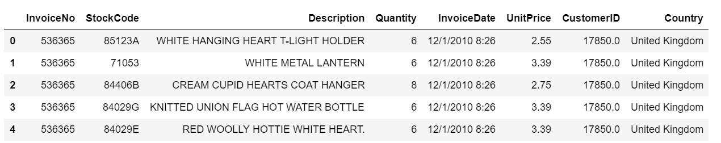
Data Overview
540k+ records with 8 fields related to products, customers and location
Resource: https://www.kaggle.com/vijayuv/onlineretail

Slide 4

Exploratory analysis
In order to perform proper analysis, analysis team will have focus on prescriptive analysis to grasp the insights of the data and know what happened on sales of the company

Slide 5
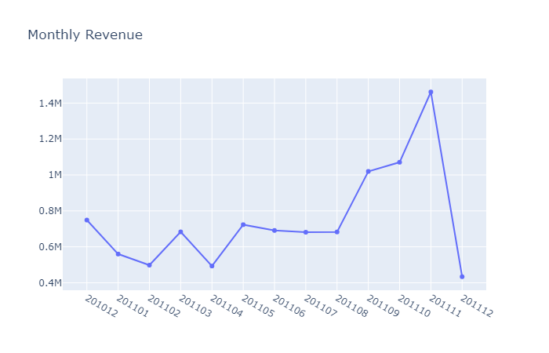
Monthly Revenue
The monthly revenue is decreasing drastically on December

Slide 6
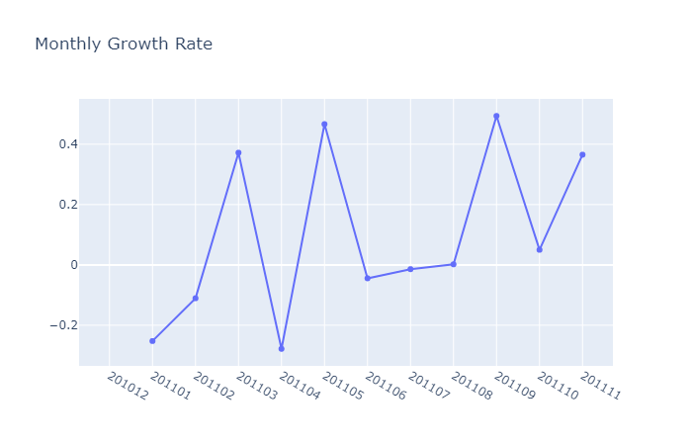
Monthly Revenue Growth Rate
The monthly growth rate is fluctuating so we need further exploration to diagnose

Slide 7
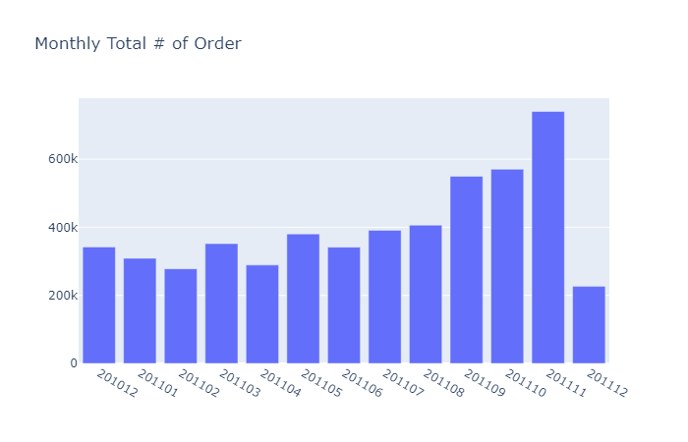
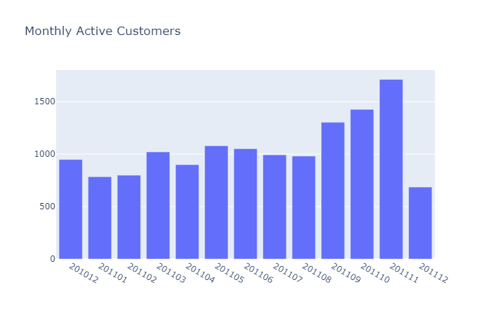
Monthly data
We can see decreases of both monthly total orders and active customers on December

Slide 8
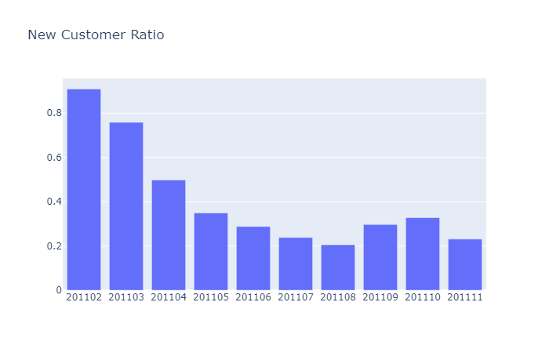
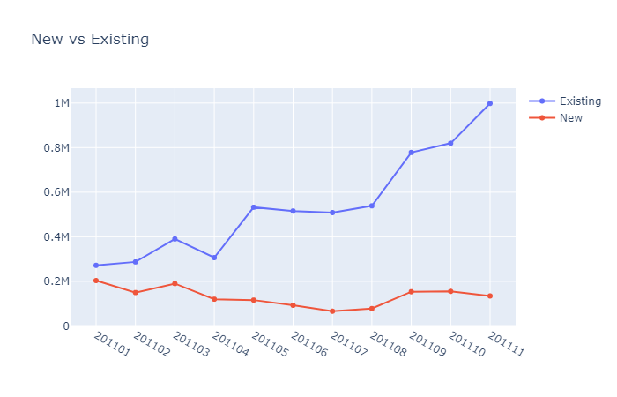
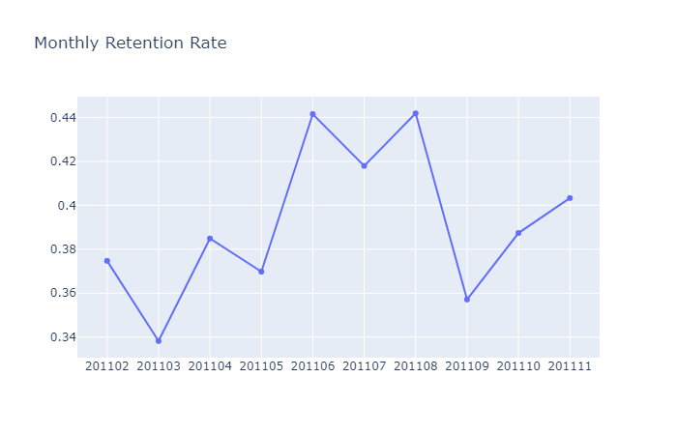
New and Existing customers
We found that the number of new customers remain stable, the new customer ratio keeps decreasing and retention rate fluctuates below 0.45 thus we should start to focus on attracting new customers and keeping existing customers.

Slide 9

Customer Segmentation
In order to have better understanding of our customers and target the right customers for the right promotion, we may create monetary, recency and frequency variables to segment them (RMF models)

Slide 10
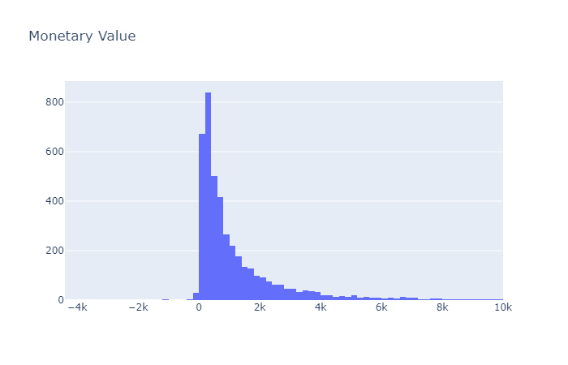
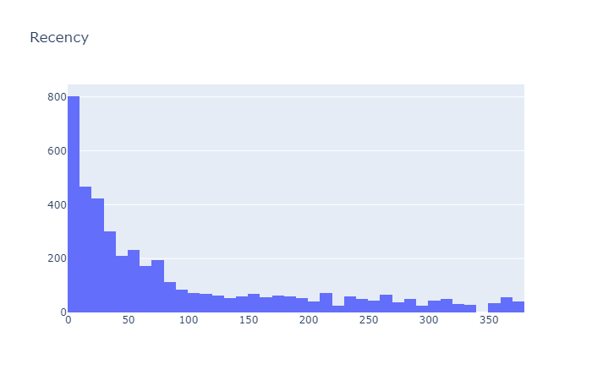
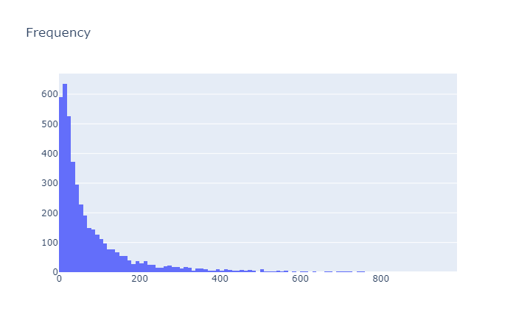
RMF variables
Monetary: the sum of the revenue of each customer
Recency: the last purchase of the customer since the day 0 (we set the last day time as day 0)
Frequency: Within the 1-year frame, how many purchases of each customer

Slide 11
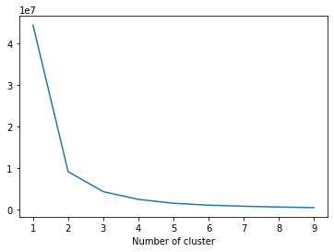
Number of Segmentation
We applied the K Means Clustering to segment the customers on Monetary, Recency and Frequency customers correspondingly. According to the Elbow method, we decide to segment the customers into three clusters.

Slide 12
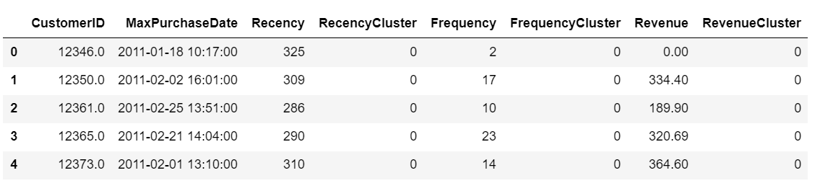
Overview of the customer’s RMF data
The overview of RMF variables and corresponding cluster: 0, 1, 2, 3 (the higher related to better values of the variables (low recencies, high frequencies and high revenues))

Slide 13
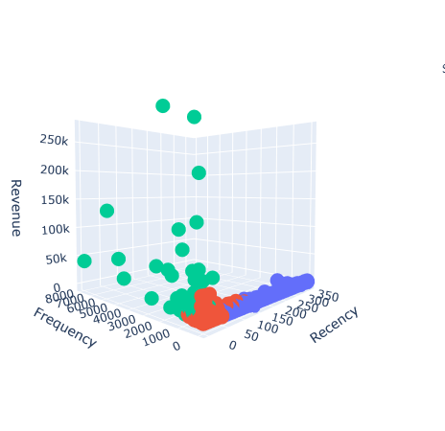
Aggregation as a label
We aggregate the scores of RMF and take the customers:
score <=2 as low-values,
score <=4 as mid-values
score >4 as high-values
Then we can plot the 3-D graphs to see the distribution of the customers
For the high-value customers we can focus on them and send them promotion to improve retention rate

Slide 14
Customer Life-time value
Besides segmentation, for the company, what we care most is how customers contribute to revenues, so we also concentrate a lot on customers Life-Time Value.

Slide 15
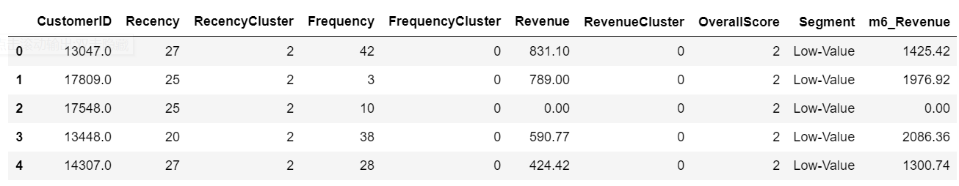
Feature Engineering for Life-Time Value prediction
We use the first three months data to create the RMF variables as previous session and take the sum of the revenues 6 months afterwards for each customer.

Slide 16
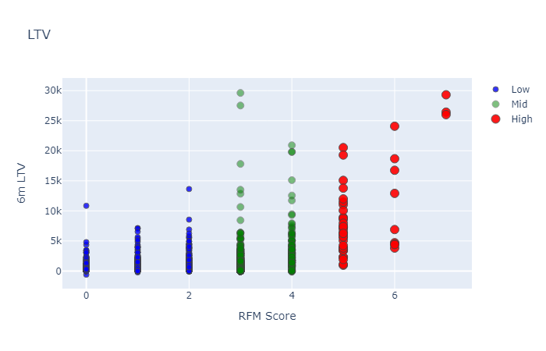
Life-Time value distributions
The Life-Time value is positively correlated with the RFM Score
We applied 3 Levels Kmeans Clustering for the Life-Time values as labels (High, Mid and Low)

Slide 17
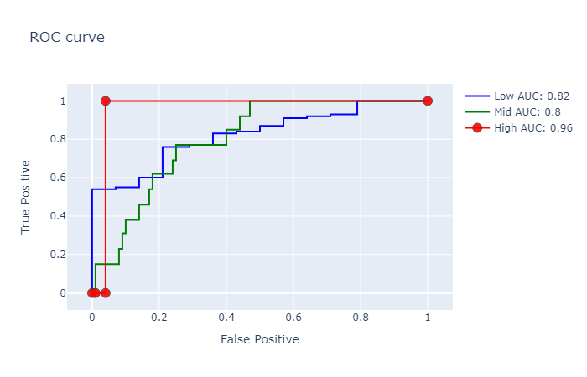
Model Training for Life-Time values
We applied XGBoost (the queen of the machine learning algorithms) to predict the Life-Time values with RMF data.
Since the AUC (area under curve) of the three labels in test datasets are all larger than 0.8, we did not need to fine-tune parameters.

Slide 18
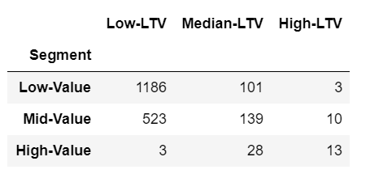
Pivot Tables of RMF and LTV
The customers with High-LTV and High-Value of segments are our golden customers and we need to try our best to maintain them. They accounts for 0.65% of our customers but contribute more than 7%+ revenues let along potential revenues.
Golden Customer Ratio: 0.0065
Contribution Ratio: 0.0732

Slide 19
Next Purchase Prediction
In order to make more practical strategies, we also focus on predicting their next purchase time frame knowing about their consuming behaviors

Slide 20
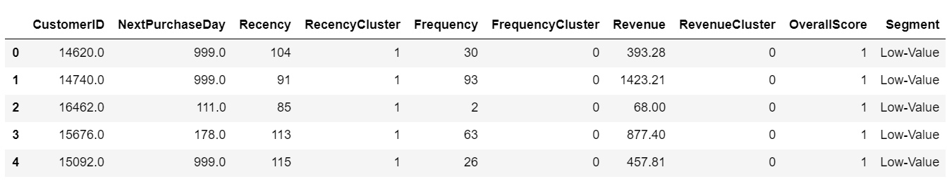
Feature Engineering of Next Purchase date
Feature Engineering of Next Purchase date
6 Months Behaviors
First Purchase in next 3 months
Next Purchase Date
We take the first purchase in the next three months’ date till the last date of 6-month time frame as Next Purchase Day. If there is not any purchases, we set as 999.

Slide 21
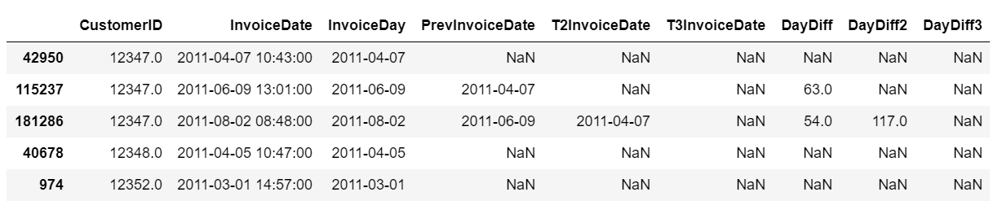
Feature Engineering of Days between the last three purchases
For each customer, we applied rolling windows to calculate the days between the last three purchases for invoice day

Slide 22
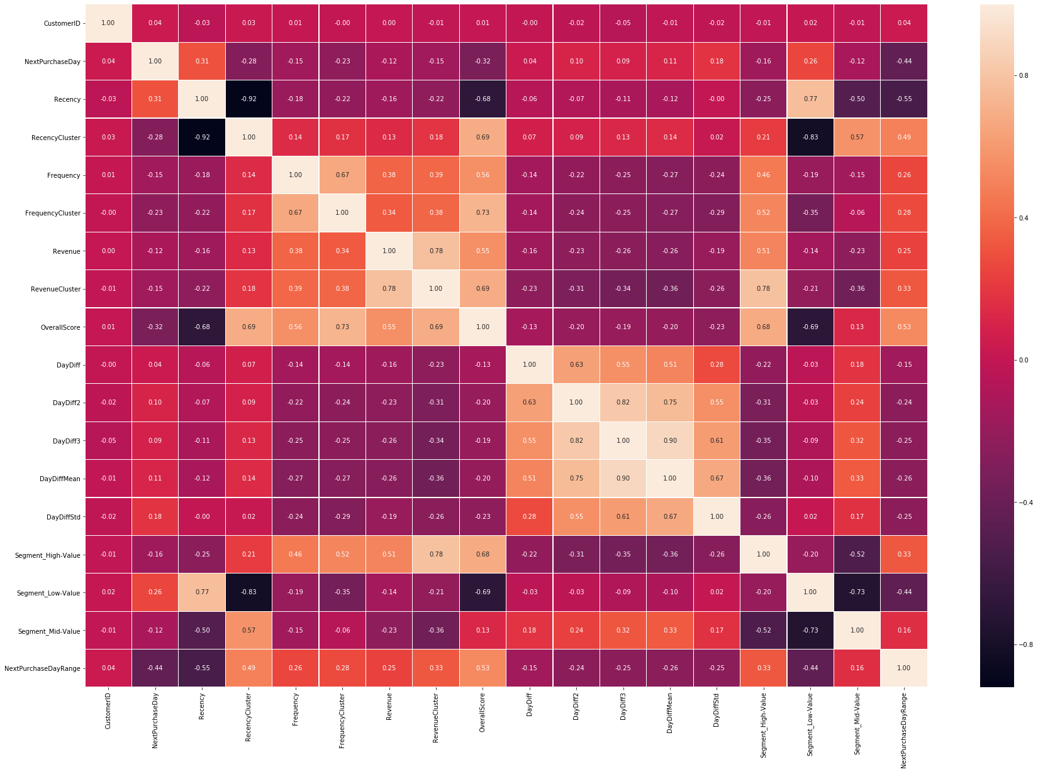
Set Next Purchase Labels
We distributes customers into three classes for their next purchases
Larger than 49 days as Low-values
21-49 days as Mid-values
Within 20 days as High-values
The correlation matrix shows the Overall RMF Score is highly correlated to the values.

Slide 23
Model Training for Next Purchase Day
We first tried different models including XGBoost. It demonstrated that none of them perform well on test dataset.
Models | Naïve Bayes | Random Forest | Logit Regression | Support Vector | XGBoost | KNN
Accuracy on test set | 0.56 | 0.56 | 0.52 | 0.47 | 0.59 | 0.45
Test Accuracies are all below 0.6

Slide 24
Bayes Optimization Hyperparameters tuning
Therefore, we tried Bayes Optimization Hyperparameters tuning for XGBoost
As a result, Accuracy of XGB classifier on training set: 0.99 Accuracy of XGB classifier on test set: 0.67
Though it is still over-fitting, it improves a lot
Fine-tuned parameters:
{'gamma': 0.8, 'learning_rate': 0.06, 'max_depth': 8.86, 'n_estimators': 112.11}

Slide 25
Strategies for next purchase date
After predicting the next purchase dates, we can launch different target marketing campaigns for customers:
Provide promotions with high-value (in segments/LTV) customers who have long next purchase day to stimulate consumption
Cut general promotion for the high-value (in segments/LTV) customers who have short next purchase day to stimulate consumption

Slide 26

Conclusion and Future work
In the project, I cover the Descriptive Analytics, Diagnostic Analytics, Predictive Analytics and Prescriptive Analytics in Customer Analytics fields.
A step-by-step analytical pipeline is constructed in Exploratory Analysis, Customer Segmentations, Predicting Life-Time Values and Next Purchase Date
Future work: If possible, we can launch the marketing campaign based on the analysis and perform ab-test. For the next step, we can adjust the previous analytical pipelines and make better promotions for the customers based on the ab-test results.

